Slide 1



Python 3 Beginner
Session : 1
Chapter 00
Course Introduction
release 1.0.0
37/39 Avenue Ledru Rollin – CS 11237 – 75750 PARIS CEDEX 12 - info@valnaos.com – www.valnaos.com Tél : 01 86 95 20 48

Slide 2

Let’s Get to Know Each Other
Python 3 Beginner
Introduce yourself in the following format:
Name
Company
Role and background
Familiarity with Python
Experience in programming, programming concepts and languages
Expectations from this course

Slide 3
Let’s Get to Know Each Other
Python 3 Beginner
Hi, I’m Charles!
Studied Computer Science from 2000 to 2007
Fell in love with Python during my first summer internship (2005)
Main uses: scripting, prototyping and data processing
Favorite language: Go
charles@cstar.io

Slide 4
Let’s Get to Know Each Other
Python 3 Beginner
Class Material
GitHub: https://github.com/cstar-industries/python-3-beginner

Slide 5
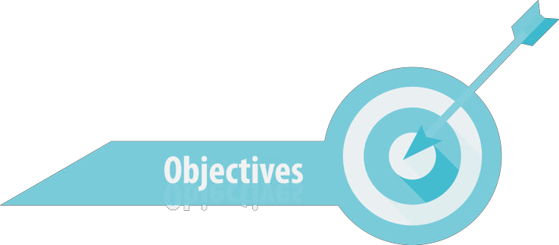
Session Objectives
Python 3 Beginner
At the end of this session, you will be able to:
Use the Python interpreter to perform simple mathematical operations.
Output any text using Python.
Capture text input from the user.
Store and retrieve information from variables.
Use numeric types int, float and complex and perform deeper math.
Manipulate text data using the str type.
Start using the Python interpreter on your own.

Slide 6
Session Syllabus
Python 3 Beginner
Chapter | Subject | Start | End | Total Time (in hours)
00 | Course Introduction | 14:00 | 14:30 | 00:30
01 | Python interpreter basics | 14:30 | 15:15 | 00:45
02 | Data types and operators: Part I | 15:15 | 16:00 | 00:45
 | Coffee Break | 16:00 | 16:15 | 00:15
03 | Data types and Operators: Part II | 16:15 | 17:00 | 00:45
04 | Work session: Variables, numbers and strings | 17:00 | 18:00 | 01:00
 | Total |  |  | 04:00

Slide 7

Session activities
Python 3 Beginner
Each session will feature a number of activities, generally scheduled in a similar fashion.
Python concepts and syntax will first be introduced theoretically with slides, followed by a quick live demo in Google Colaboratory. Each chapter will be concluded by a short exercise session reviewing the presented topics.
Finally, each class will end with a work session where students can use all the concepts they learned to solve some exercises. This is will also be a time to ask questions about the class topics, and gain deeper understanding about Python.

Slide 8

Cloud Technology Associate
Copyright © 2018 | 9
Q&A
37/39 Avenue Ledru Rollin – CS 11237 – 75750 PARIS CEDEX 12 - info@valnaos.com – www.valnaos.com Tél : 01 86 95 20 48

Slide 9
Python 3 Beginner
Chapter 01
Getting to know Python
release 1.0.0
37/39 Avenue Ledru Rollin – CS 11237 – 75750 PARIS CEDEX 12 - info@valnaos.com – www.valnaos.com Tél : 01 86 95 20 48

Slide 10
The Python Language
Python 3 Beginner
Invented in 1991 by Guido van Rossum
“Dynamically-typed, garbage-collected, interpreted language”
Multi-paradigm: Procedural – Object-oriented – Functional
Reference interpreter: CPython
RIP Python 2 (2000-2020)
Hello Python 3 ! (2008)
Notes:
Guido: “Benevolent Dictator For Life”
Dynamically-typed: not like C or Java, we will talk about this later
Garbage-collected: not like C, but like Java. No worry about manual memory management.
Python is (usually) based on C: integrating code from foreign libraries, embedding the Python interpreter, binding, speed and efficiency

Slide 11
The Zen of Python
Python 3 Beginner
Beautiful is better than ugly.
Explicit is better than implicit.
Simple is better than complex.
Complex is better than complicated.
Flat is better than nested.
Sparse is better than dense.
Readability counts.
Special cases aren't special enough to break the rules.
Although practicality beats purity.
Errors should never pass silently.
Unless explicitly silenced.
In the face of ambiguity, refuse the temptation to guess.
There should be one-- and preferably only one --obvious way to do it.
Although that way may not be obvious at first unless you're Dutch.
Now is better than never.
Although never is often better than *right* now.
If the implementation is hard to explain, it's a bad idea.
If the implementation is easy to explain, it may be a good idea.
Namespaces are one honking great idea -- let's do more of those!

Slide 12
The Zen of Python
Python 3 Beginner
Beautiful is better than ugly.
Explicit is better than implicit.
Simple is better than complex.
Complex is better than complicated.
Flat is better than nested.
Sparse is better than dense.
Readability counts.
Special cases aren't special enough to break the rules.
Although practicality beats purity.
Errors should never pass silently.
Unless explicitly silenced.
In the face of ambiguity, refuse the temptation to guess.
There should be one-- and preferably only one --obvious way to do it.
Although that way may not be obvious at first unless you're Dutch.
Now is better than never.
Although never is often better than *right* now.
If the implementation is hard to explain, it's a bad idea.
If the implementation is easy to explain, it may be a good idea.
Namespaces are one honking great idea -- let's do more of those!
Notes:
Future you is one of the people you’re writing code for

Slide 13
The Zen of Python
Python 3 Beginner
Beautiful is better than ugly.
Explicit is better than implicit.
Simple is better than complex.
Complex is better than complicated.
Flat is better than nested.
Sparse is better than dense.
Readability counts.
Special cases aren't special enough to break the rules.
Although practicality beats purity.
Errors should never pass silently.
Unless explicitly silenced.
In the face of ambiguity, refuse the temptation to guess.
There should be one– and preferably only one –obvious way to do it.
Although that way may not be obvious at first unless you're Dutch.
Now is better than never.
Although never is often better than *right* now.
If the implementation is hard to explain, it's a bad idea.
If the implementation is easy to explain, it may be a good idea.
Namespaces are one honking great idea -- let's do more of those!
Notes:
Jab to Perl

Slide 14
The Python Interpreter
Python 3 Beginner
Reference shell: python
Favorite shell: IPython
Online development environment: Google Colaboratory (https://colab.research.google.com/)

Slide 15
Let’s write some code!
Python 3 Beginner
print("Hello World!")
Hello World!
Notes:
* The `print` function outputs whatever we tell it to

Slide 16
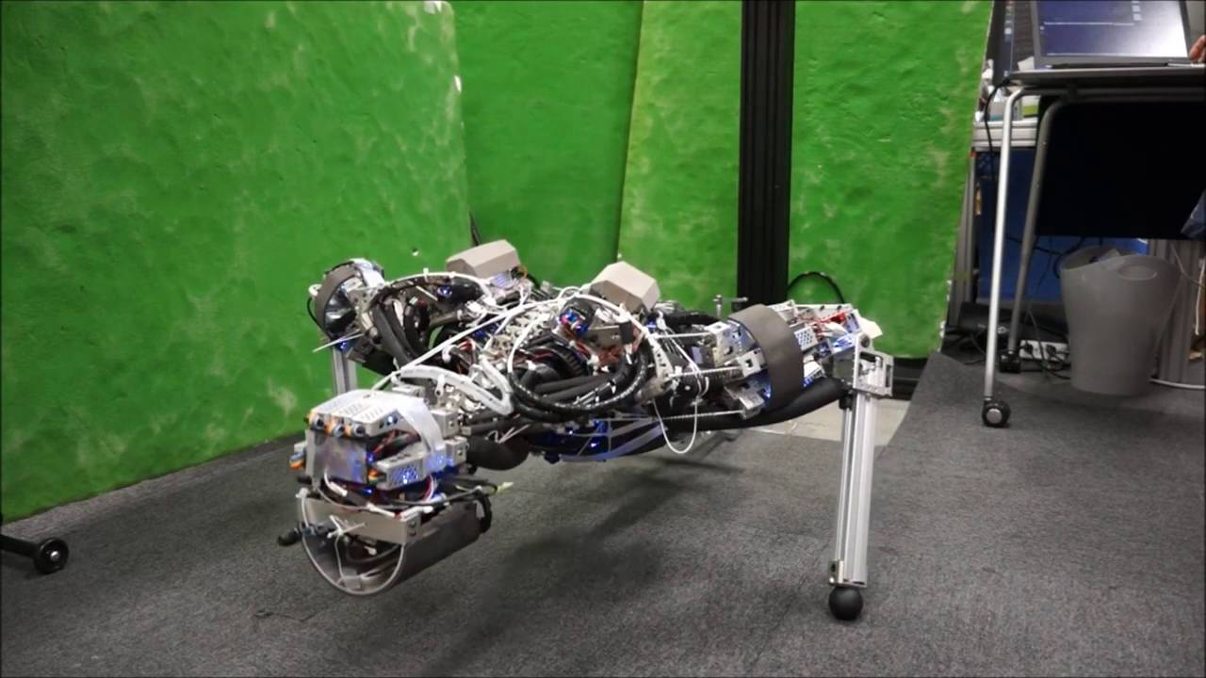
Workout Time!
Python 3 Beginner
Chapter 1 Exercises link
Notes:
https://github.com/cstar-industries/python-3-beginner/blob/master/001-First-Steps/First%20Steps%20-%20Chap%2001%20-%20Exercises.ipynb

Slide 17

Chapter Summary
Python 3 Beginner
This chapter covered the following:
The history of the Python language and the philosophy behind it.
Writing code directly into the Python interpreter shell.
Outputting text using the print function.
Saving data to variables.
Capturing user input from the keyboard using the input function.

Slide 18
Python 3 Beginner
Chapter 02
Data types and operators: Part I
release 1.0.0
37/39 Avenue Ledru Rollin – CS 11237 – 75750 PARIS CEDEX 12 - info@valnaos.com – www.valnaos.com Tél : 01 86 95 20 48

Slide 19
Basic number types
Python 3 Beginner
Two main numeric types in Python
int for integers
float for rational numbers (“floating point”)
Integers have infinite precision
Floating-point limited to IEEE-754 “double-precision” (64-bit)

Slide 20
Let’s write some code!
Python 3 Beginner
print(1)
print(0.5)
print(1 / 2)
print(3 ** 4)
1
0.5
0.5
81

Slide 21
Basic mathematical operations
Python 3 Beginner
Addition, subtraction, multiplication, division
+, -, *, /
Python respects mathematical order or operations
Use parentheses to change priority
You can nest parentheses
(2 * (1 + 2)) ** 2
36

Slide 22
More mathematical operations
Python 3 Beginner
Exponentiation: **
Integer division: //
10 // 3
3
Remainder (modulo): %
10 % 3
1

Slide 23
Deeper math
Python 3 Beginner
Python has a complex type
3+2j
Absolute value: abs
The math library contains many mathematical functions (sqrt, sin, cos…)
import math

Slide 24
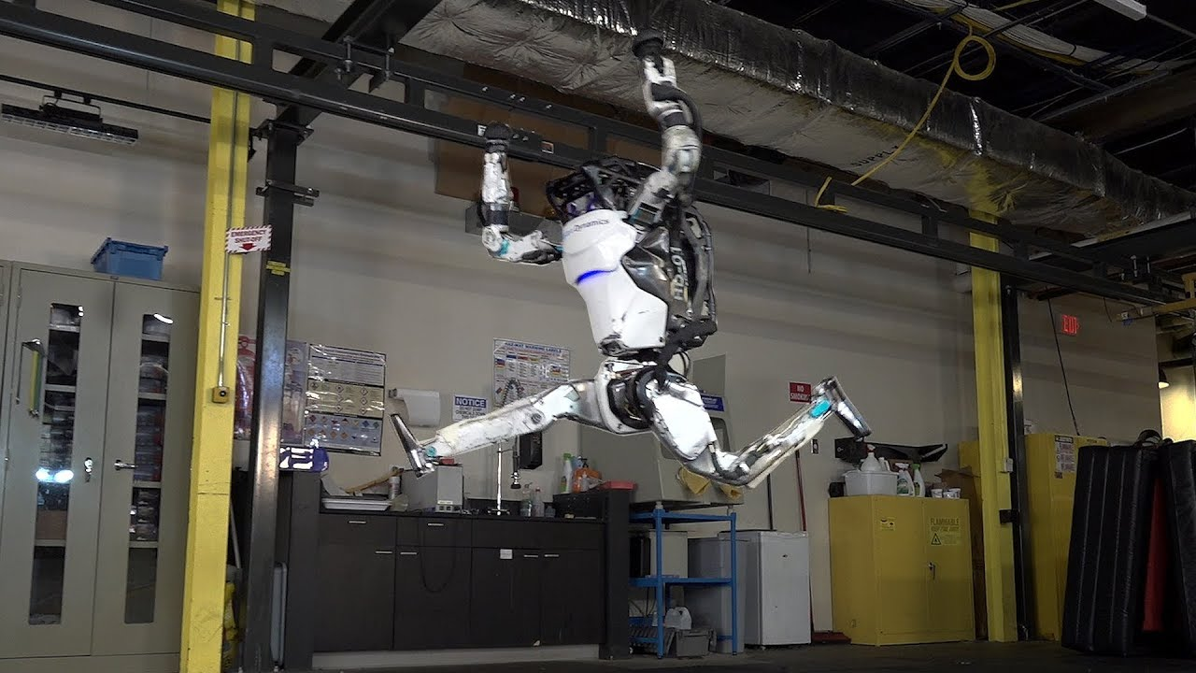
Workout Time!
Python 3 Beginner
Chapter 2 Exercises link
Notes:
https://github.com/cstar-industries/python-3-beginner/blob/master/001-First-Steps/First%20Steps%20-%20Chap%2002%20-%20Exercises.ipynb

Slide 25
Chapter Summary
Python 3 Beginner
This chapter covered the following:
Basic numeric types in Python: int and float
Simple math operations using operators
Order of operations in Python
Complex number type
Deeper math functions from the math module

Slide 26
Python 3 Beginner
Chapter 03
Data types and operators: Part II
release 1.0.0
37/39 Avenue Ledru Rollin – CS 11237 – 75750 PARIS CEDEX 12 - info@valnaos.com – www.valnaos.com Tél : 01 86 95 20 48

Slide 27
Handling text in Python
Python 3 Beginner
Text data type: str (string)
Strings are any arbitrary text enclosed between single or double quotes
"Hello"
'World’
Special characters can be input using “escape sequences”
\n, \t, etc.
\x41, \u262d

Slide 28
Let’s write some code!
Python 3 Beginner
opening_line = 'It was a bright cold day in April, and the clocks were striking thirteen.'
print(opening_line)
It was a bright cold day in April, and the clocks were striking thirteen.

Slide 29
Operations on Python strings
Python 3 Beginner
Concatenation: +
"spam" + "eggs"
spameggs
Repetition: *
5 * "spam "
spam spam spam spam spam
Length: len
len("hello")
5

Slide 30
Anatomy of a string
Python 3 Beginner
A Python string is a list (string) of characters.
S | p | a | m | ⎵ | & | ⎵ | e | g | g | s
0
1
2
3
4
5
6
7
8
9
10
11
The string "Spam & eggs" is shown above as an array of characters
The length of the string is 11 characters
Each character can be referred to by its index
Notes:
What is the index of the first character?
What is the index of the last character?
How does that relate to the length of the string?
What is character [4]?

Slide 31
Let’s write some code!
Python 3 Beginner
print(3 * "spam, " + "and eggs")
spam, spam, spam, and eggs

Slide 32
The str type
Python 3 Beginner
The str type has many methods.
A method is “something that the variable can perform” (a function bound to an object).
Change casing: upper, lower, title
Change whitespace: strip
Extract words: split

Slide 33
Type conversions
Python 3 Beginner
A type can sometimes be converted to another type.
Write the type name, followed by the value between parentheses:
a = int("12")
print(30 + a)
42
print("9 + 3 = " + str(12))
9 + 3 = 12

Slide 34
Format strings
Python 3 Beginner
Format strings provide a concise and readable way to mix variables, expressions and literal strings
age = 12
print(f"My brother is {age} years old.")
My brother is 12 years old.
a = 12
print(f"{a} squared is {a*a}")
12 squared is 144

Slide 35
Let’s write some code!
Python 3 Beginner
int("deadbeef", 16)
3735928559

Slide 36
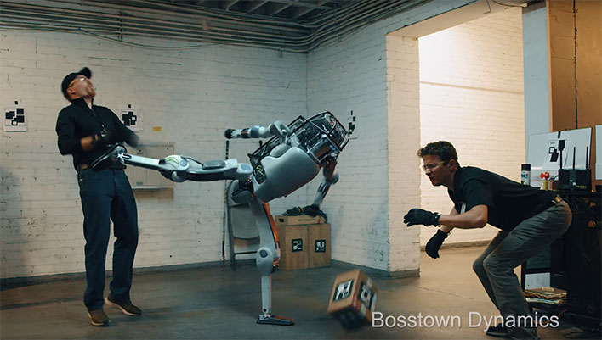
Workout Time!
Python 3 Beginner
Chapter 3 Exercises link
Notes:
https://github.com/cstar-industries/python-3-beginner/blob/master/001-First-Steps/First%20Steps%20-%20Chap%2003%20-%20Exercises.ipynb

Slide 37
Chapter Summary
Python 3 Beginner
This chapter covered the following:
Python’s text type: str
Indexing, length and ranges of strings
str has methods (remember this word)
Converting between types
Using format strings to produce readable code that outputs variables mixed with literal text.

Slide 38
Cloud Technology Associate
Copyright © 2018 | 9
Q&A
37/39 Avenue Ledru Rollin – CS 11237 – 75750 PARIS CEDEX 12 - info@valnaos.com – www.valnaos.com Tél : 01 86 95 20 48

Slide 39
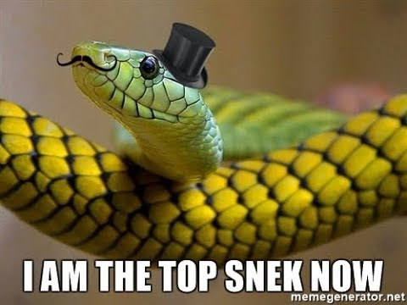
Workshop
Python 3 Beginner
Session 1 Workshop link
Notes:
https://github.com/cstar-industries/python-3-beginner/blob/master/001-First-Steps/First%20Steps%20-%20Workshop.ipynb

Slide 40
Thank you for your attention!

